Slide 1
Parameterizing non-canonical amino acids for peptide and protein design in Rosetta
Benjamin P. Brown, PhD
Research Assistant Professor
Vanderbilt University Department of Chemistry

Slide 2
This presentation will combine lecture materials with a live tutorial on non-canonical amino acid parameter creation
Overview of Rosetta params files
Methods with which to generate rotamer libraries
Step-by-step summary of how to generate params files
Live tutorial on params generation
Discussion on reference energies for non-canonical amino acids

Slide 3
This presentation will combine lecture materials with a live tutorial on non-canonical amino acid parameter creation
Overview of Rosetta params files
Methods with which to generate rotamer libraries
Step-by-step summary of how to generate params files
Live tutorial on params generation
Discussion on reference energies for non-canonical amino acids

Slide 4
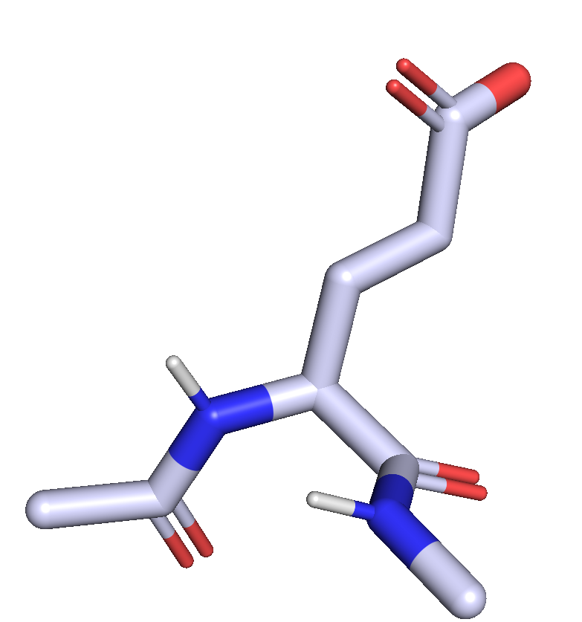
Params files define how individual atoms respond to perturbation during a Rosetta simulation
ATOM 7 N GLU 2 -0.289 -2.292 -0.976 1.00 0.00 N
ATOM 8 CA GLU 2 0.231 -0.909 -0.991 1.00 0.00 C
ATOM 9 C GLU 2 1.780 -0.904 -1.003 1.00 0.00 C
ATOM 10 O GLU 2 2.445 0.011 -1.485 1.00 0.00 O
ATOM 11 CB GLU 2 -0.310 -0.193 0.250 1.00 0.00 C
ATOM 12 CG GLU 2 -0.117 1.320 0.238 1.00 0.00 C
ATOM 13 CD GLU 2 -0.818 2.013 1.412 1.00 0.00 C
ATOM 14 OE1 GLU 2 -1.301 1.257 2.301 1.00 0.00 O
Atomic partial charges?
Connectivity?
Bond types?
Bond angles?
Dihedral angles?
Special behaviors?

Slide 5
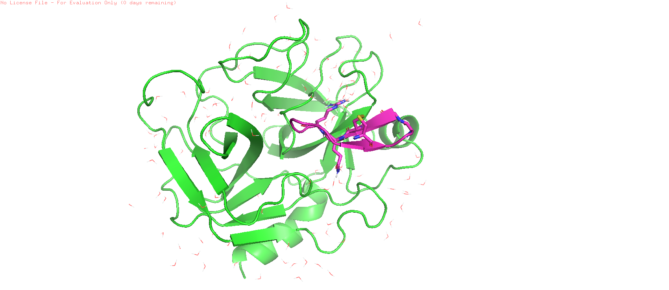
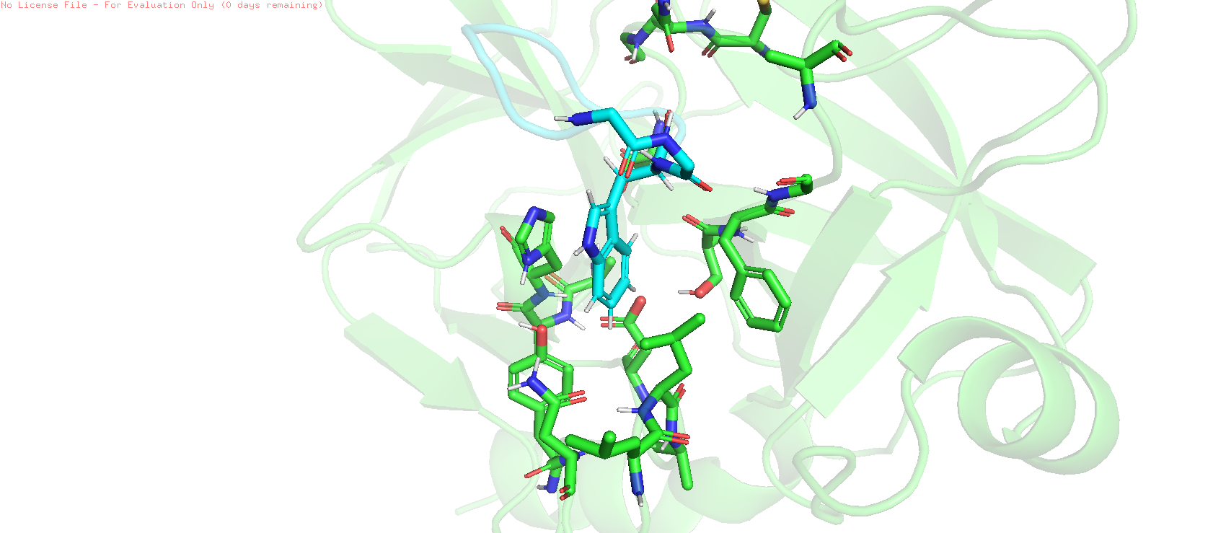
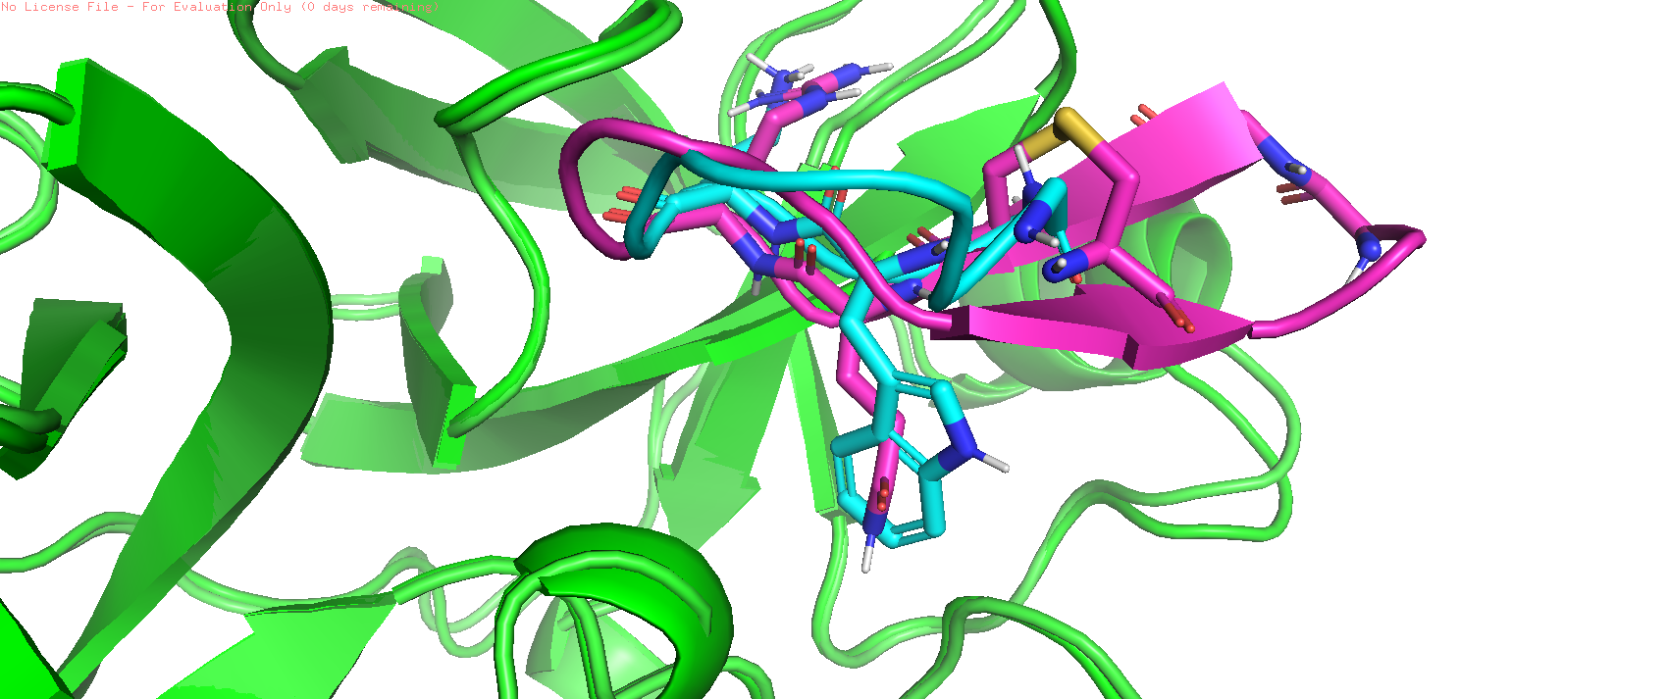
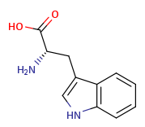
How would we encode all the topological and non-coordinate information for a non-canonical derivative of Tryptophan?
(4) Design a TRP derivative library to scan hotspot
(2) Redesign smaller peptide
(3) Identify a potential hotspot interaction
R = F, Cl, Br, CF₃, CH₃, OCH₃, etc.
(1) Refine structure of native protein-peptide complex

Slide 6
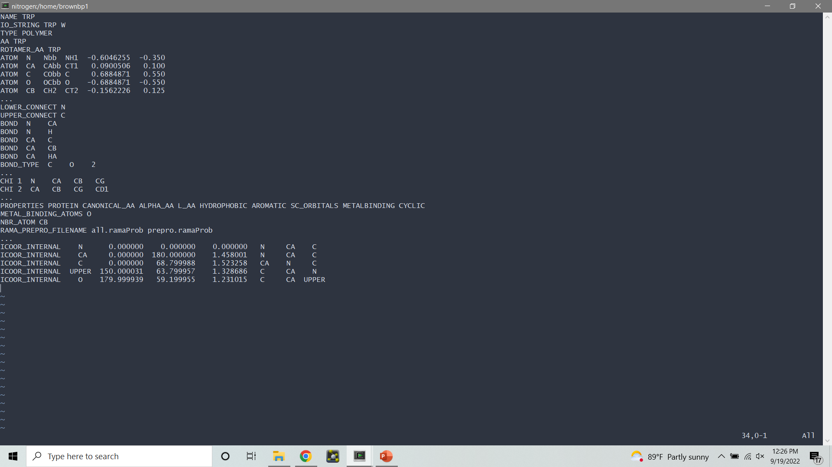
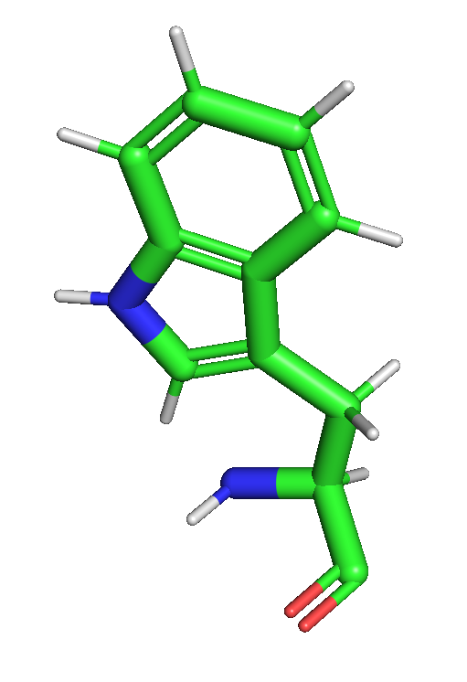
Topological and other non-coordinate information is stored in a params file
https://www.rosettacommons.org/docs/latest/rosetta_basics/file_types/Residue-Params-file

Slide 7
The first few lines contain basic information about the residue type
NAME The name of the Residue. Must be unique among all residues loaded into Rosetta
TYPE The type of residue being represented, should be 'LIGAND' for ligands, or 'POLYMER' for amino acids, DNA and RNA bases, or other polymer building-blocks.
IO_STRING The 3 letter and 1 letter codes representing the residue. 3 letter code is not unique; it does not need to be the same as the name. 1 letter code is Z by default.
AA The amino acid type. Should be "UNK" for ligands, or for most non-canonicals.
https://www.rosettacommons.org/docs/latest/rosetta_basics/file_types/Residue-Params-file

Slide 8
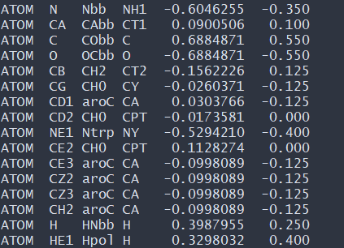
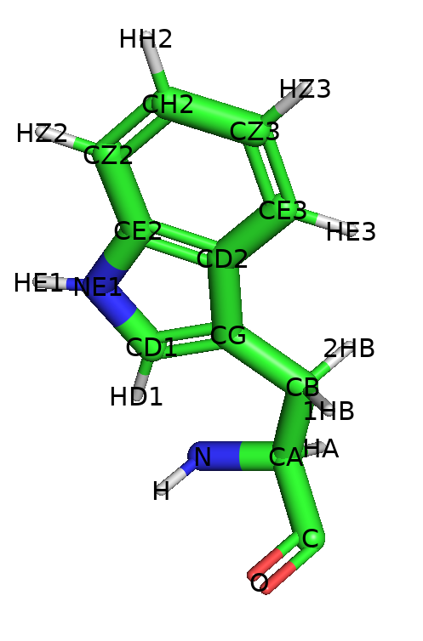
The ATOM block relates each PDB atom to a templated atom type
0
1
2
3
4
0 – PDB atom name
1 – Rosetta atom type name
2 – MM/CHARMM atom type name
3 – Partial charge
4 – Secondary partial charge (requires “chemical::parse_charge” flag)
https://www.rosettacommons.org/docs/latest/rosetta_basics/file_types/Residue-Params-file

Slide 9
The BOND block defines the connectivity between each atom
Connects current residue, i, to i-1 and i+1 residues
BOND_TYPE can be used to specify bond orders other than default 1.
https://www.rosettacommons.org/docs/latest/rosetta_basics/file_types/Residue-Params-file

Slide 10
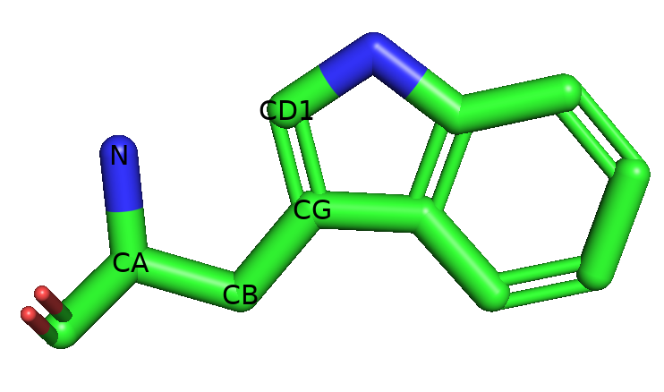
The CHI block defines chi dihedral angles
https://www.rosettacommons.org/docs/latest/rosetta_basics/file_types/Residue-Params-file

Slide 11
After the CHI block and before the ICOOR block we typically include additional properties
PROPERTIES A series of properties describing this ligand type or residue type. For an exhaustive list of allowed properties, see the file source/src/core/chemical/residue_properties/general_properties.list in the main Rosetta repository.
NBR_ATOM The PDB name of the "neighbor atom".
NET_FORMAL_CHARGE The overall charge on this residue type or ligand type. This must be an integer, though it can be positive or negative. If not supplied, the net formal charge is assumed to be 0. (Note: this is used by the netcharge score term to determine the net charge of a pose or region.)
METAL_BINDING_ATOMS A list of the names of atoms in this residue/ligand that can form covalent bonds to metal ions. Only residues with the METALBINDING property can define metal binding atoms.
https://www.rosettacommons.org/docs/latest/rosetta_basics/file_types/Residue-Params-file

Slide 12
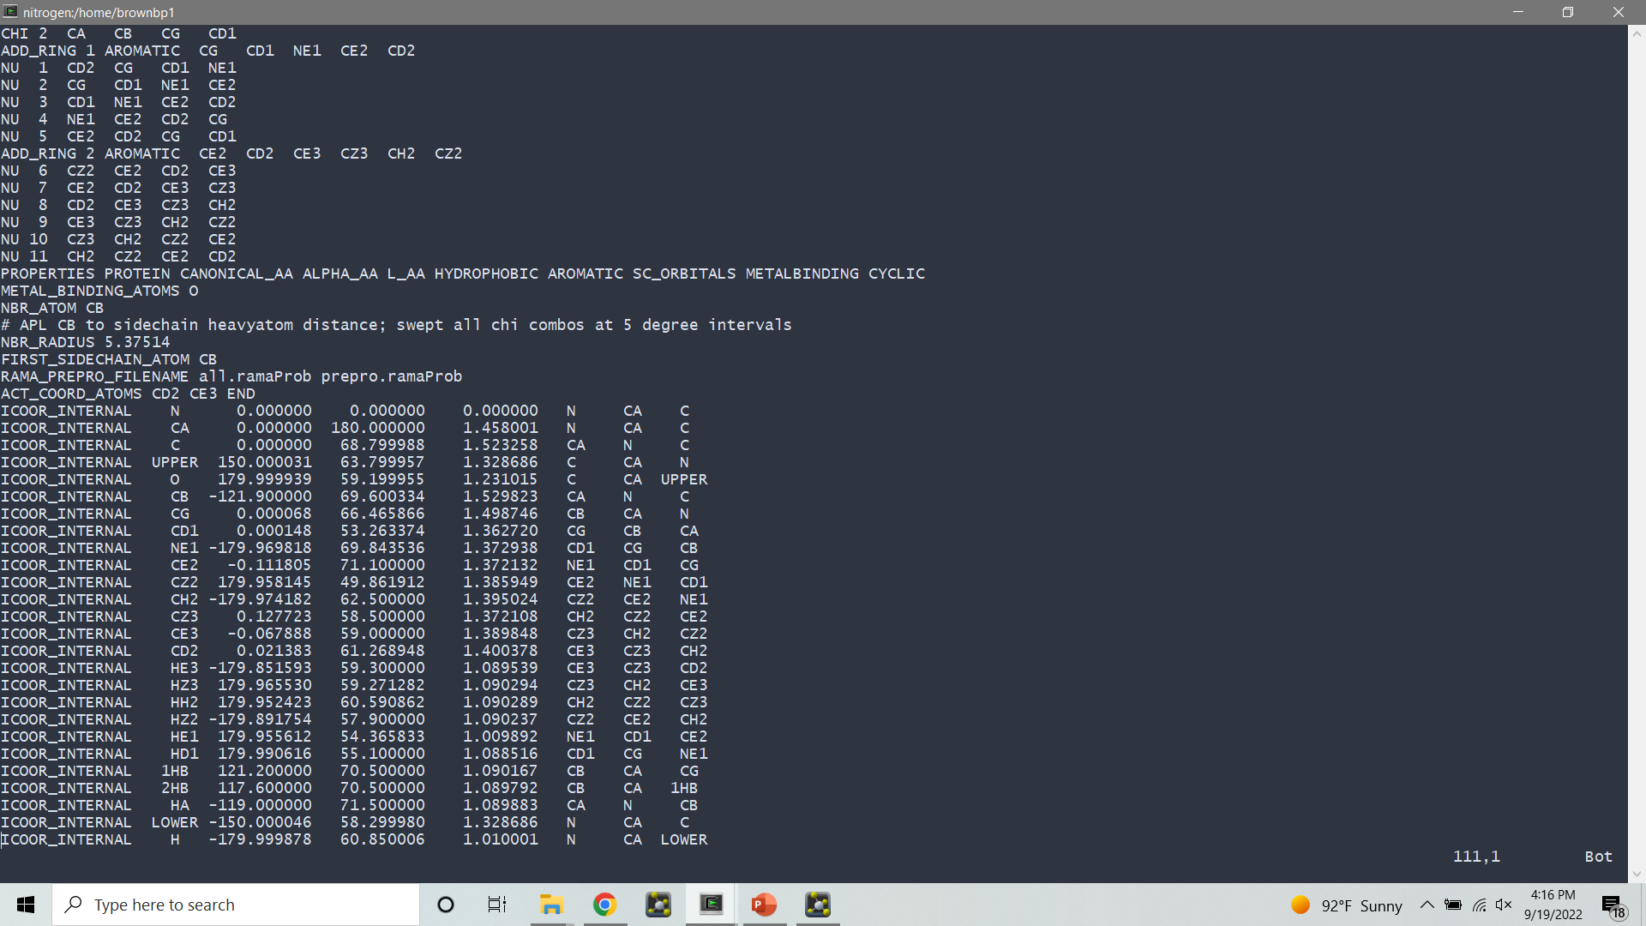
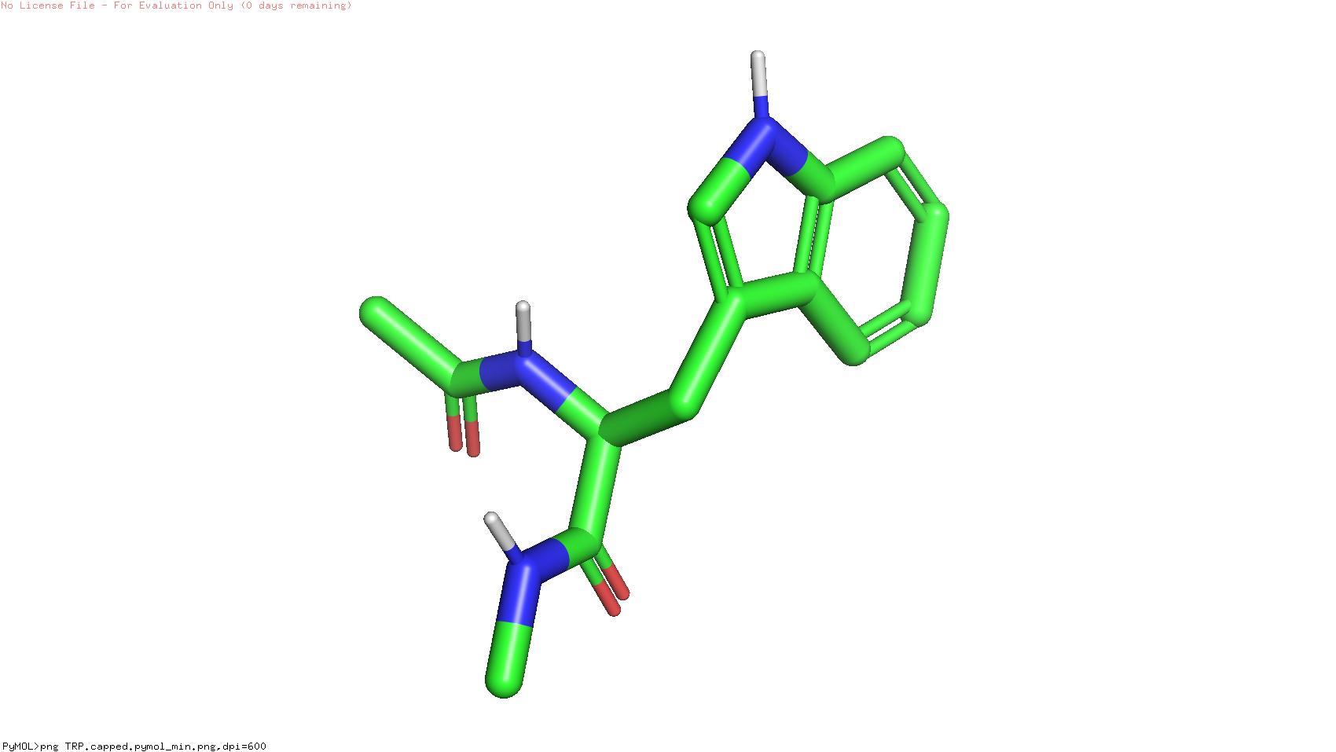
The ICOOR_INTERNAL block defines the internal coordinates of the residue type
0
1
2
3
4
5
6
N
LOWER
CA
C
0 – Child atom
UPPER
1 – Phi dihedral angle (6-5-4-0)
O
2 – Theta improper angle (180 – Angle(0-4-5))
3 – Distance (0-4)
https://www.rosettacommons.org/docs/latest/rosetta_basics/file_types/Residue-Params-file

Slide 13
Questions?

Slide 14
This presentation will combine lecture materials with a live tutorial on non-canonical amino acid parameter creation
Overview of Rosetta params files
Methods with which to generate rotamer libraries
Step-by-step summary of how to generate params files
Live tutorial on params generation
Discussion on reference energies for non-canonical amino acids

Slide 15
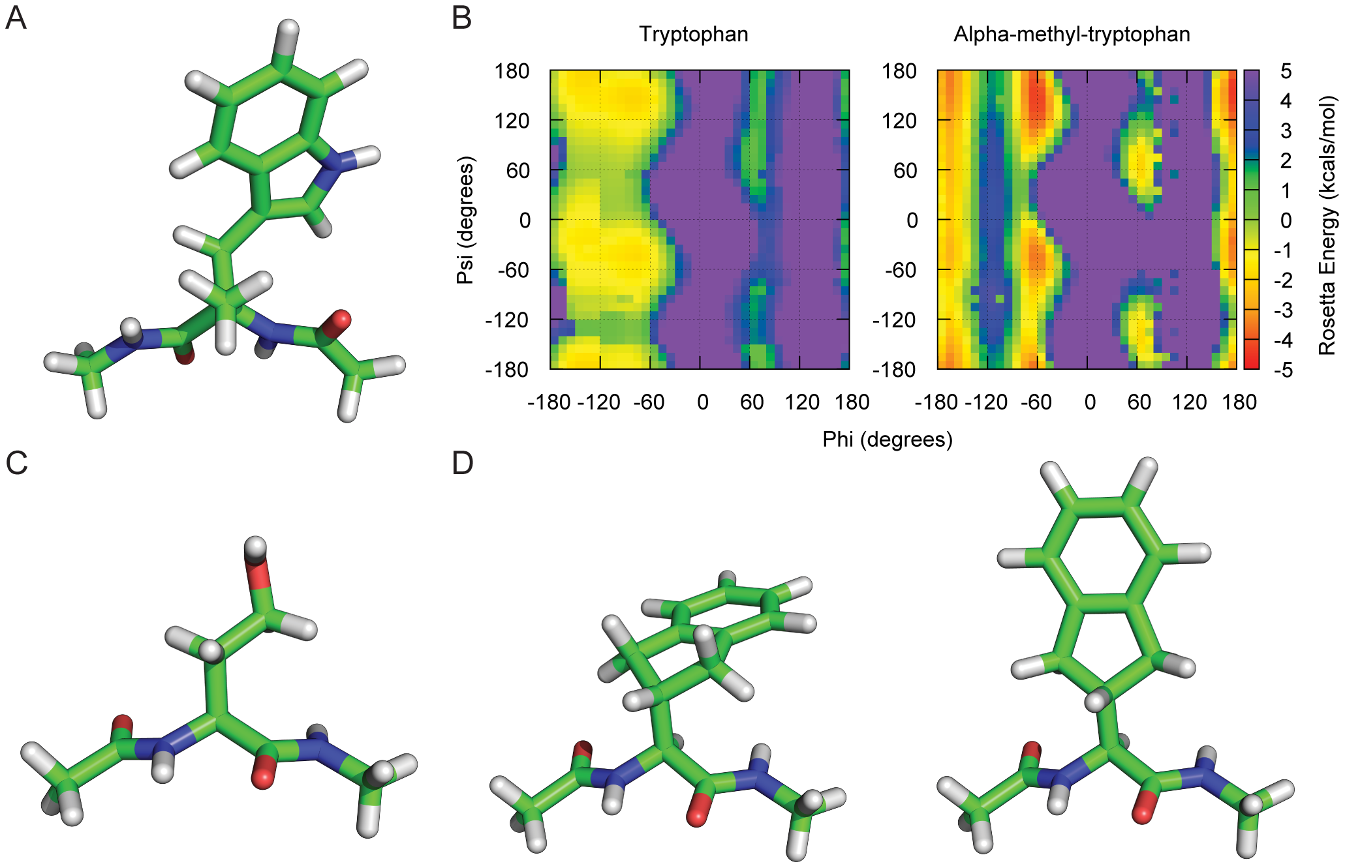
We need to be able to generate accurate Ramachandran statistics for non-canonical amino acid backbones
Renfrew et al., 2012, PLOS One, https://journals.plos.org/plosone/article?id=10.1371/journal.pone.0032637

Slide 16
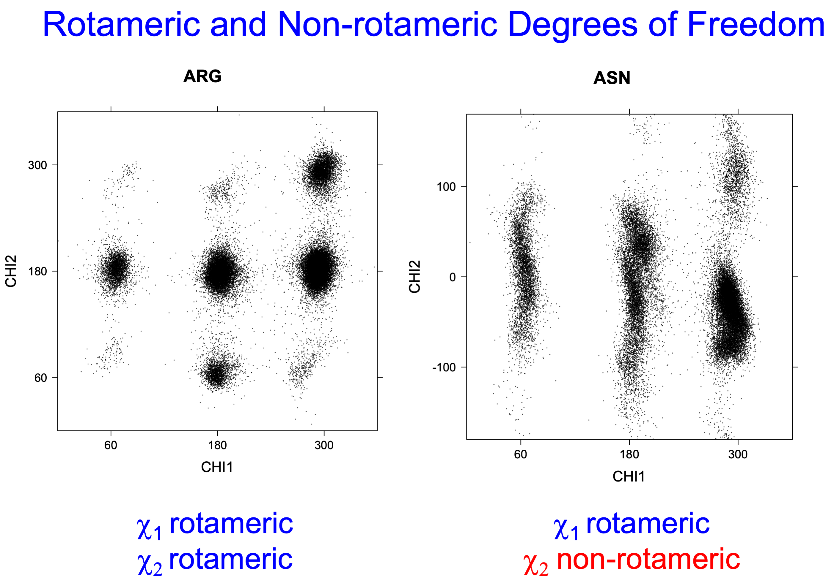
Rosetta samples high probability sidechain conformations based on statistics from the Dunbrack rotamer libraries
http://dunbrack.fccc.edu/bbdep2010/ConformationalAnalysis.php

Slide 17
We have three general strategies for assigning rotamer probabilities for NCAAs
Oε1_{i}
Oε2_{i}
Cδ_{i}
Rotamer propensities obtained from:
Parent canonical amino acid
MakeRotLib application – REF2015
Small molecule conformer generator
Cβ_{i}
Cγ_{i}
Cα_{i}
N_{i}
C_{i}
C_{i-1}
O_{i}
N_{i+1}

Slide 18
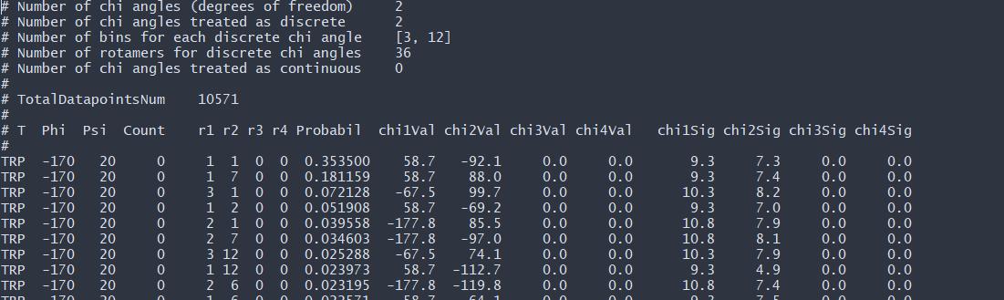
Each amino acid residue in Rosetta is assigned a backbone-dependent rotamer library

Slide 19
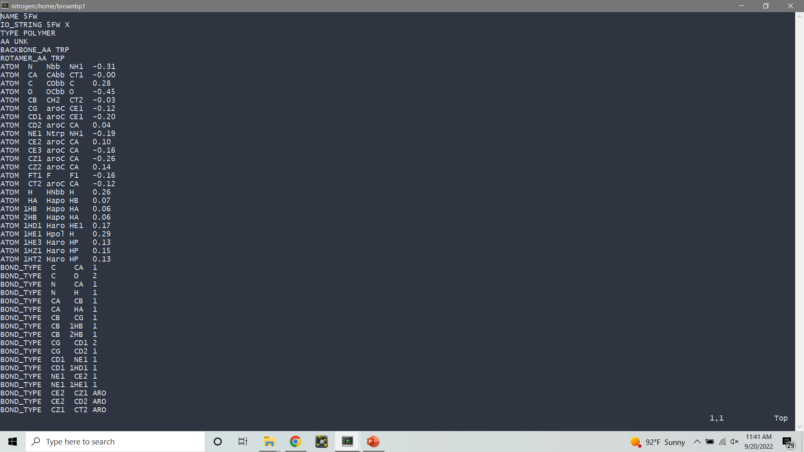
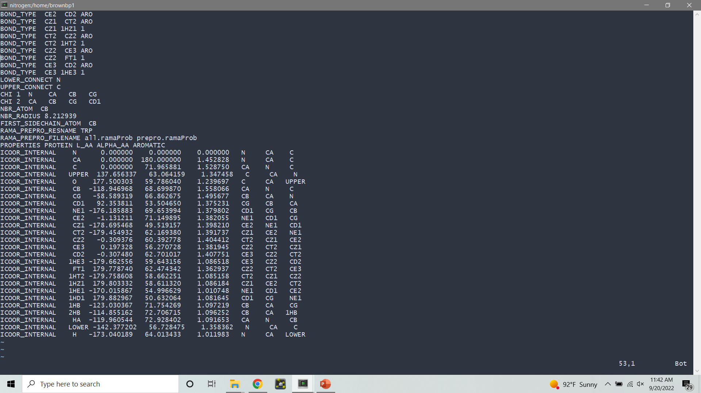
The parent rotamer approach can be implemented with a few minor additions to the params file of a non-canonical residue
Fast and easy setup for NCAAs that have an obvious CAA analog
Mimics the sampling behavior of all the other CAAs in the protein (i.e., is “Rosetta-like”)
Not suitable for exotic NCAAs with no CAA analog
Does not account for sampling changes that may occur with even a “minor” chemical change

Slide 20
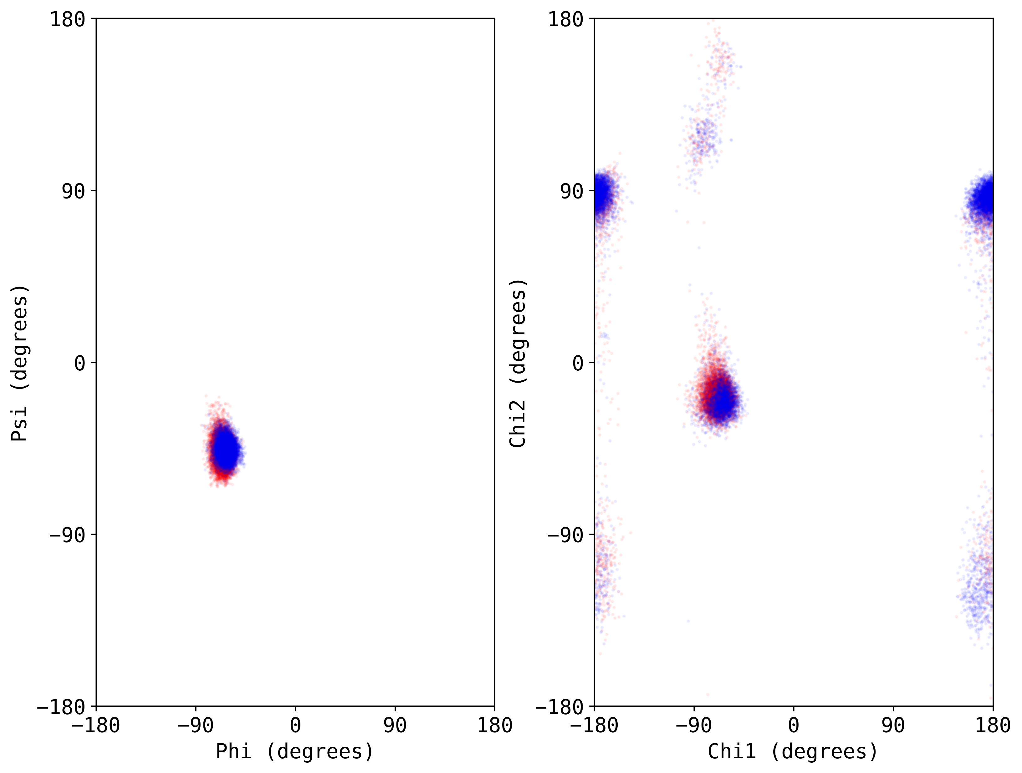
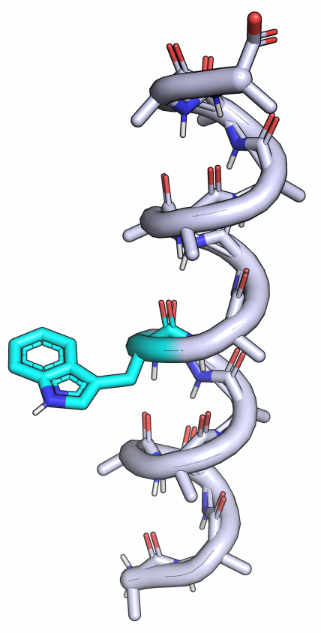
The parent rotamer approach applies statistics from a suitably similar canonical amino acid
TRP
5F-TRP

Slide 21
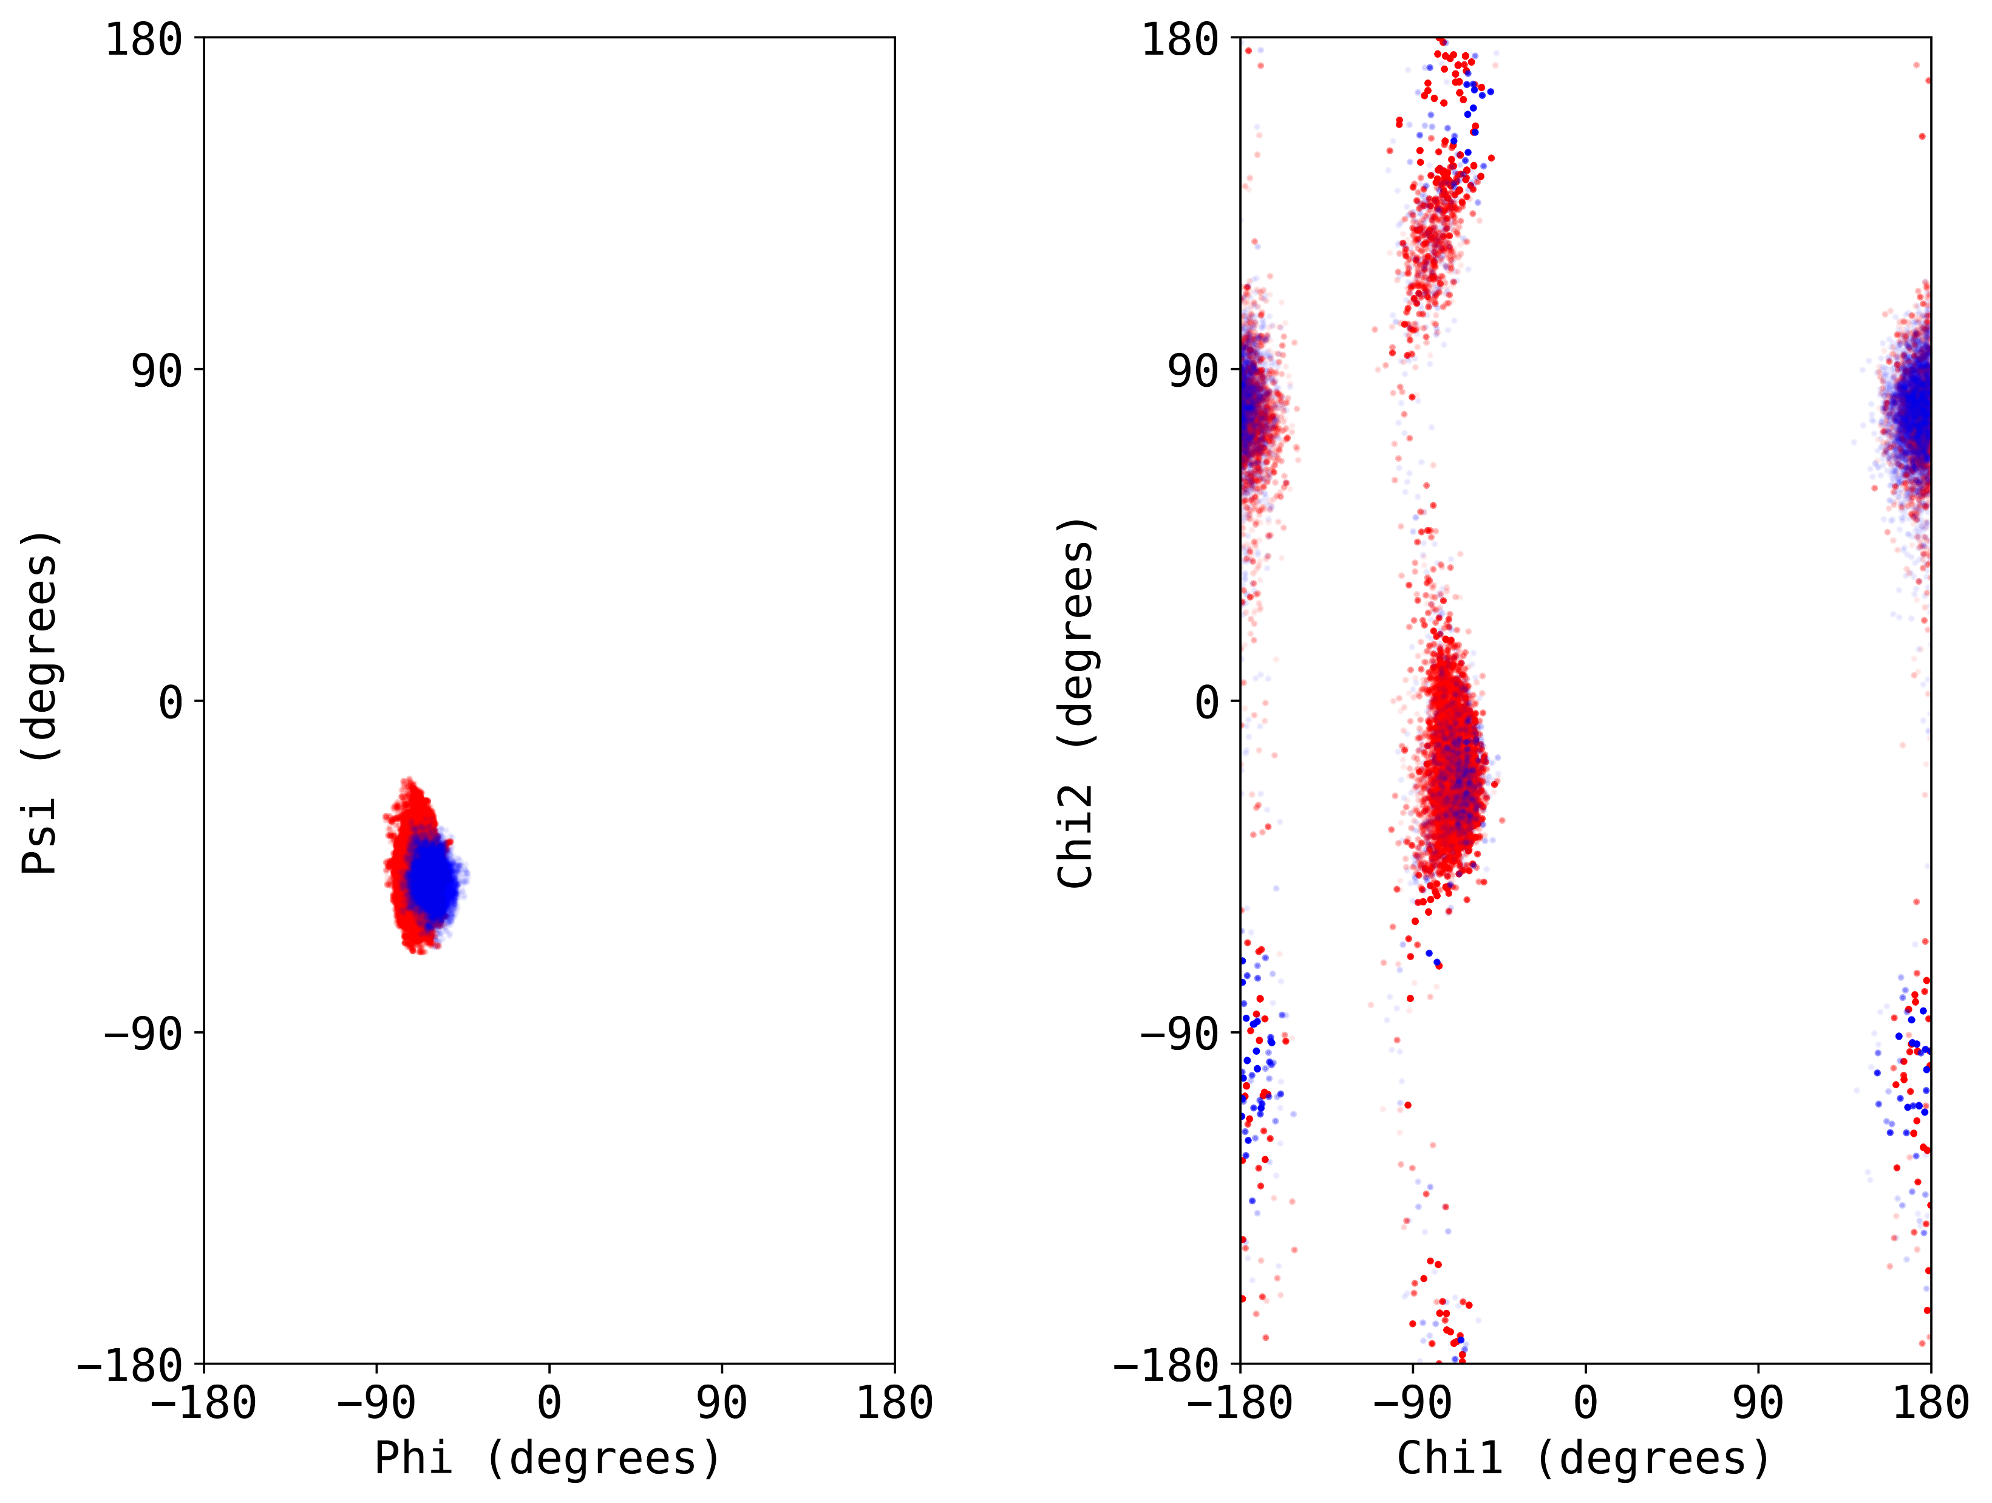
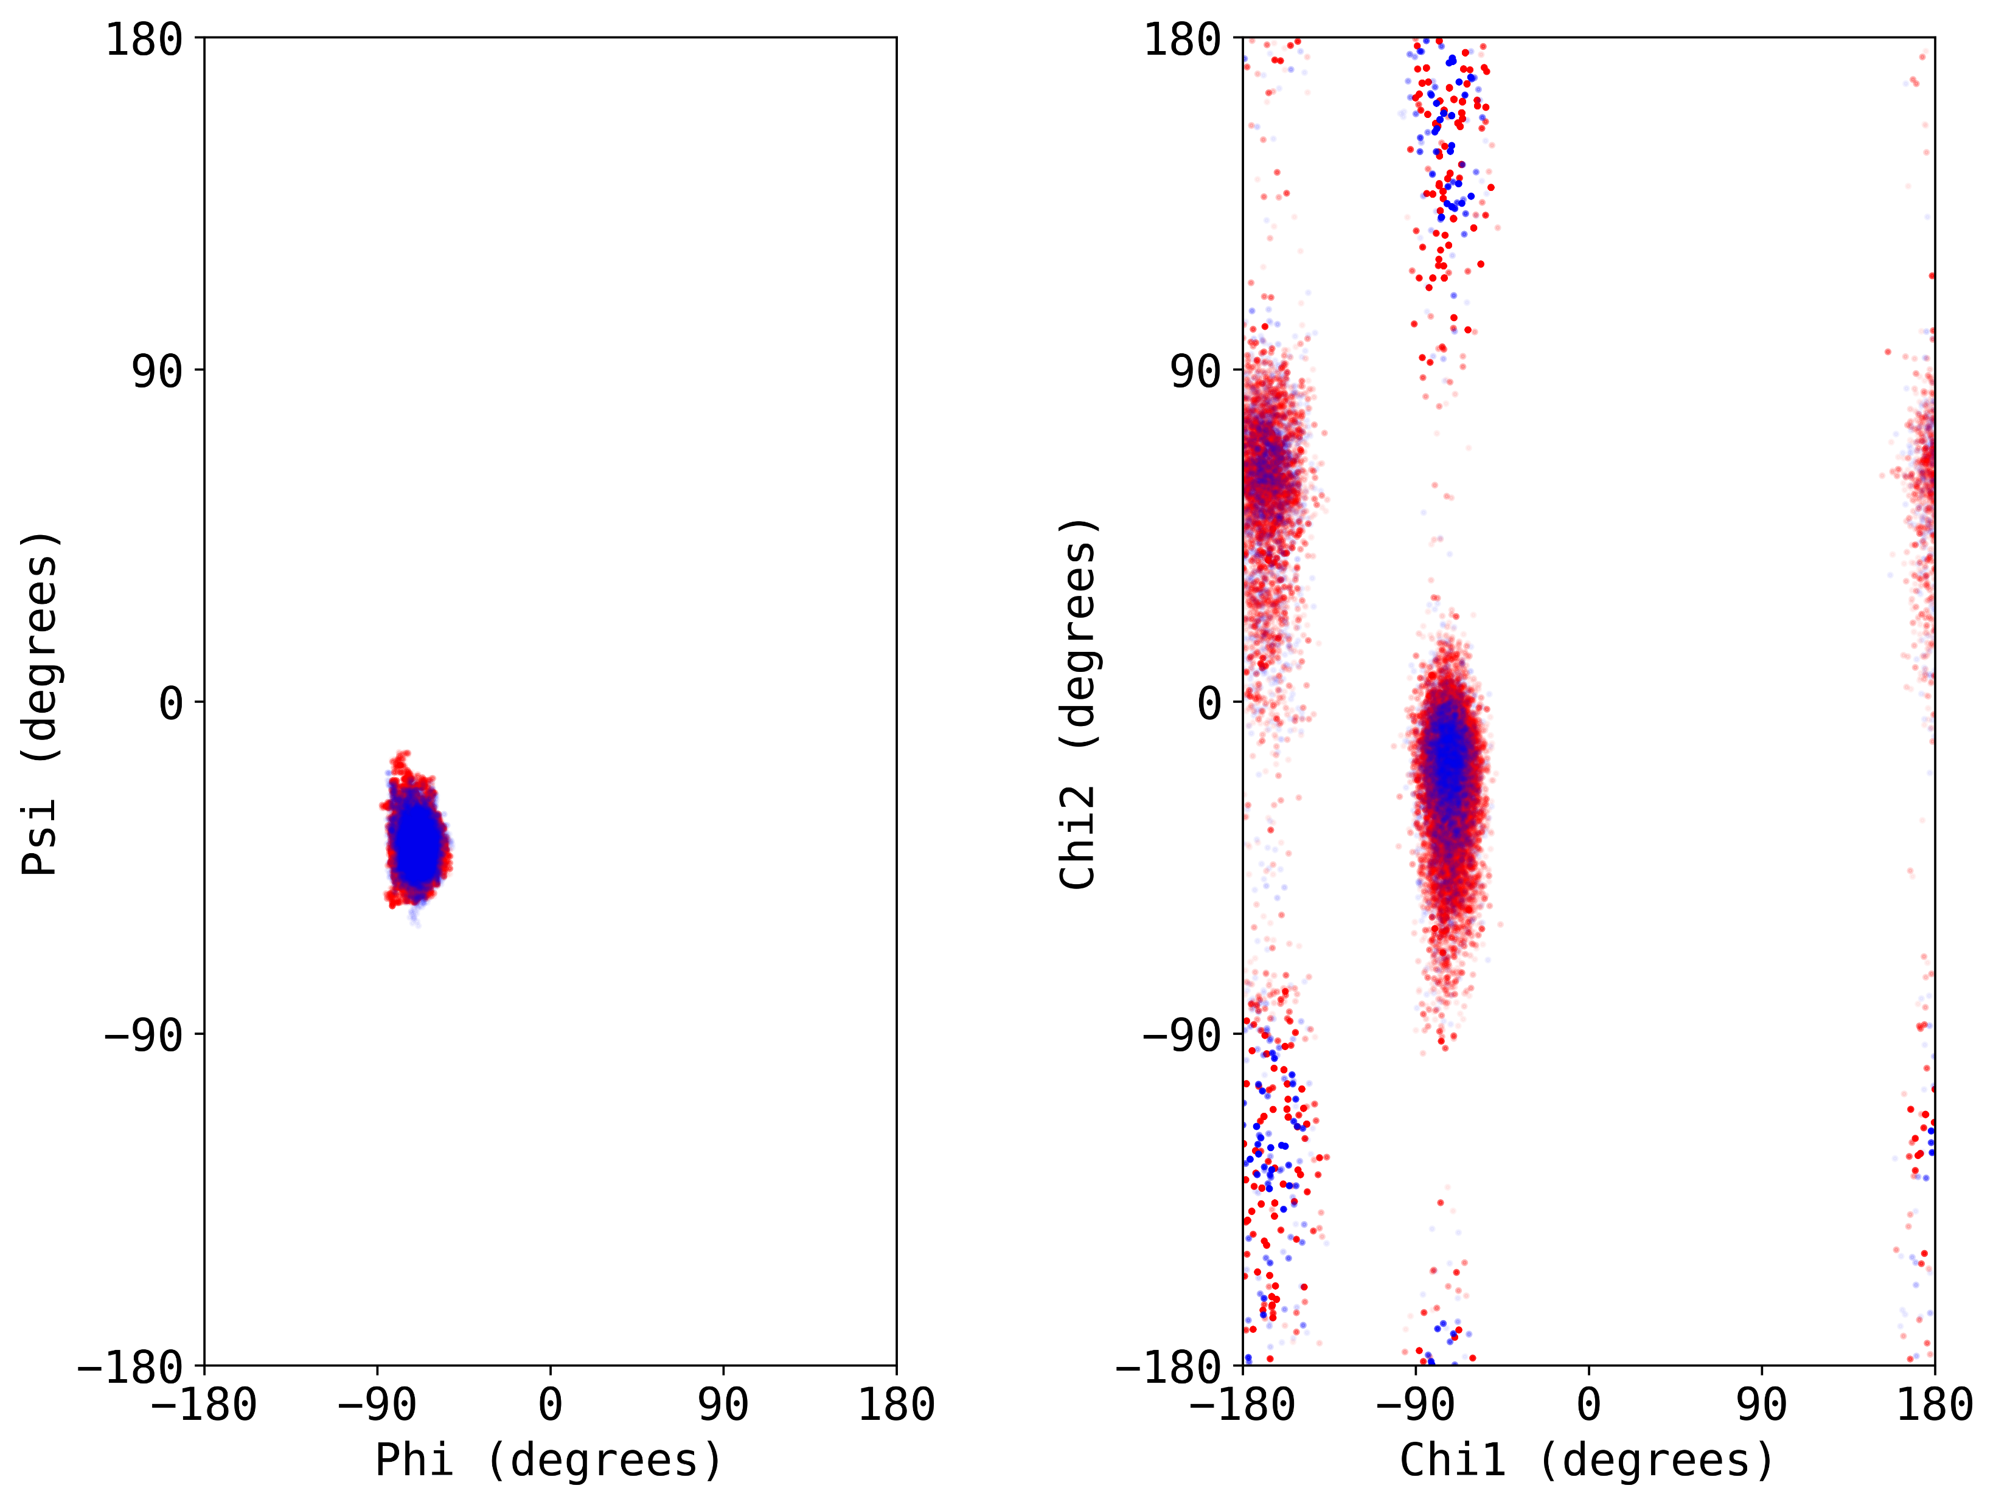
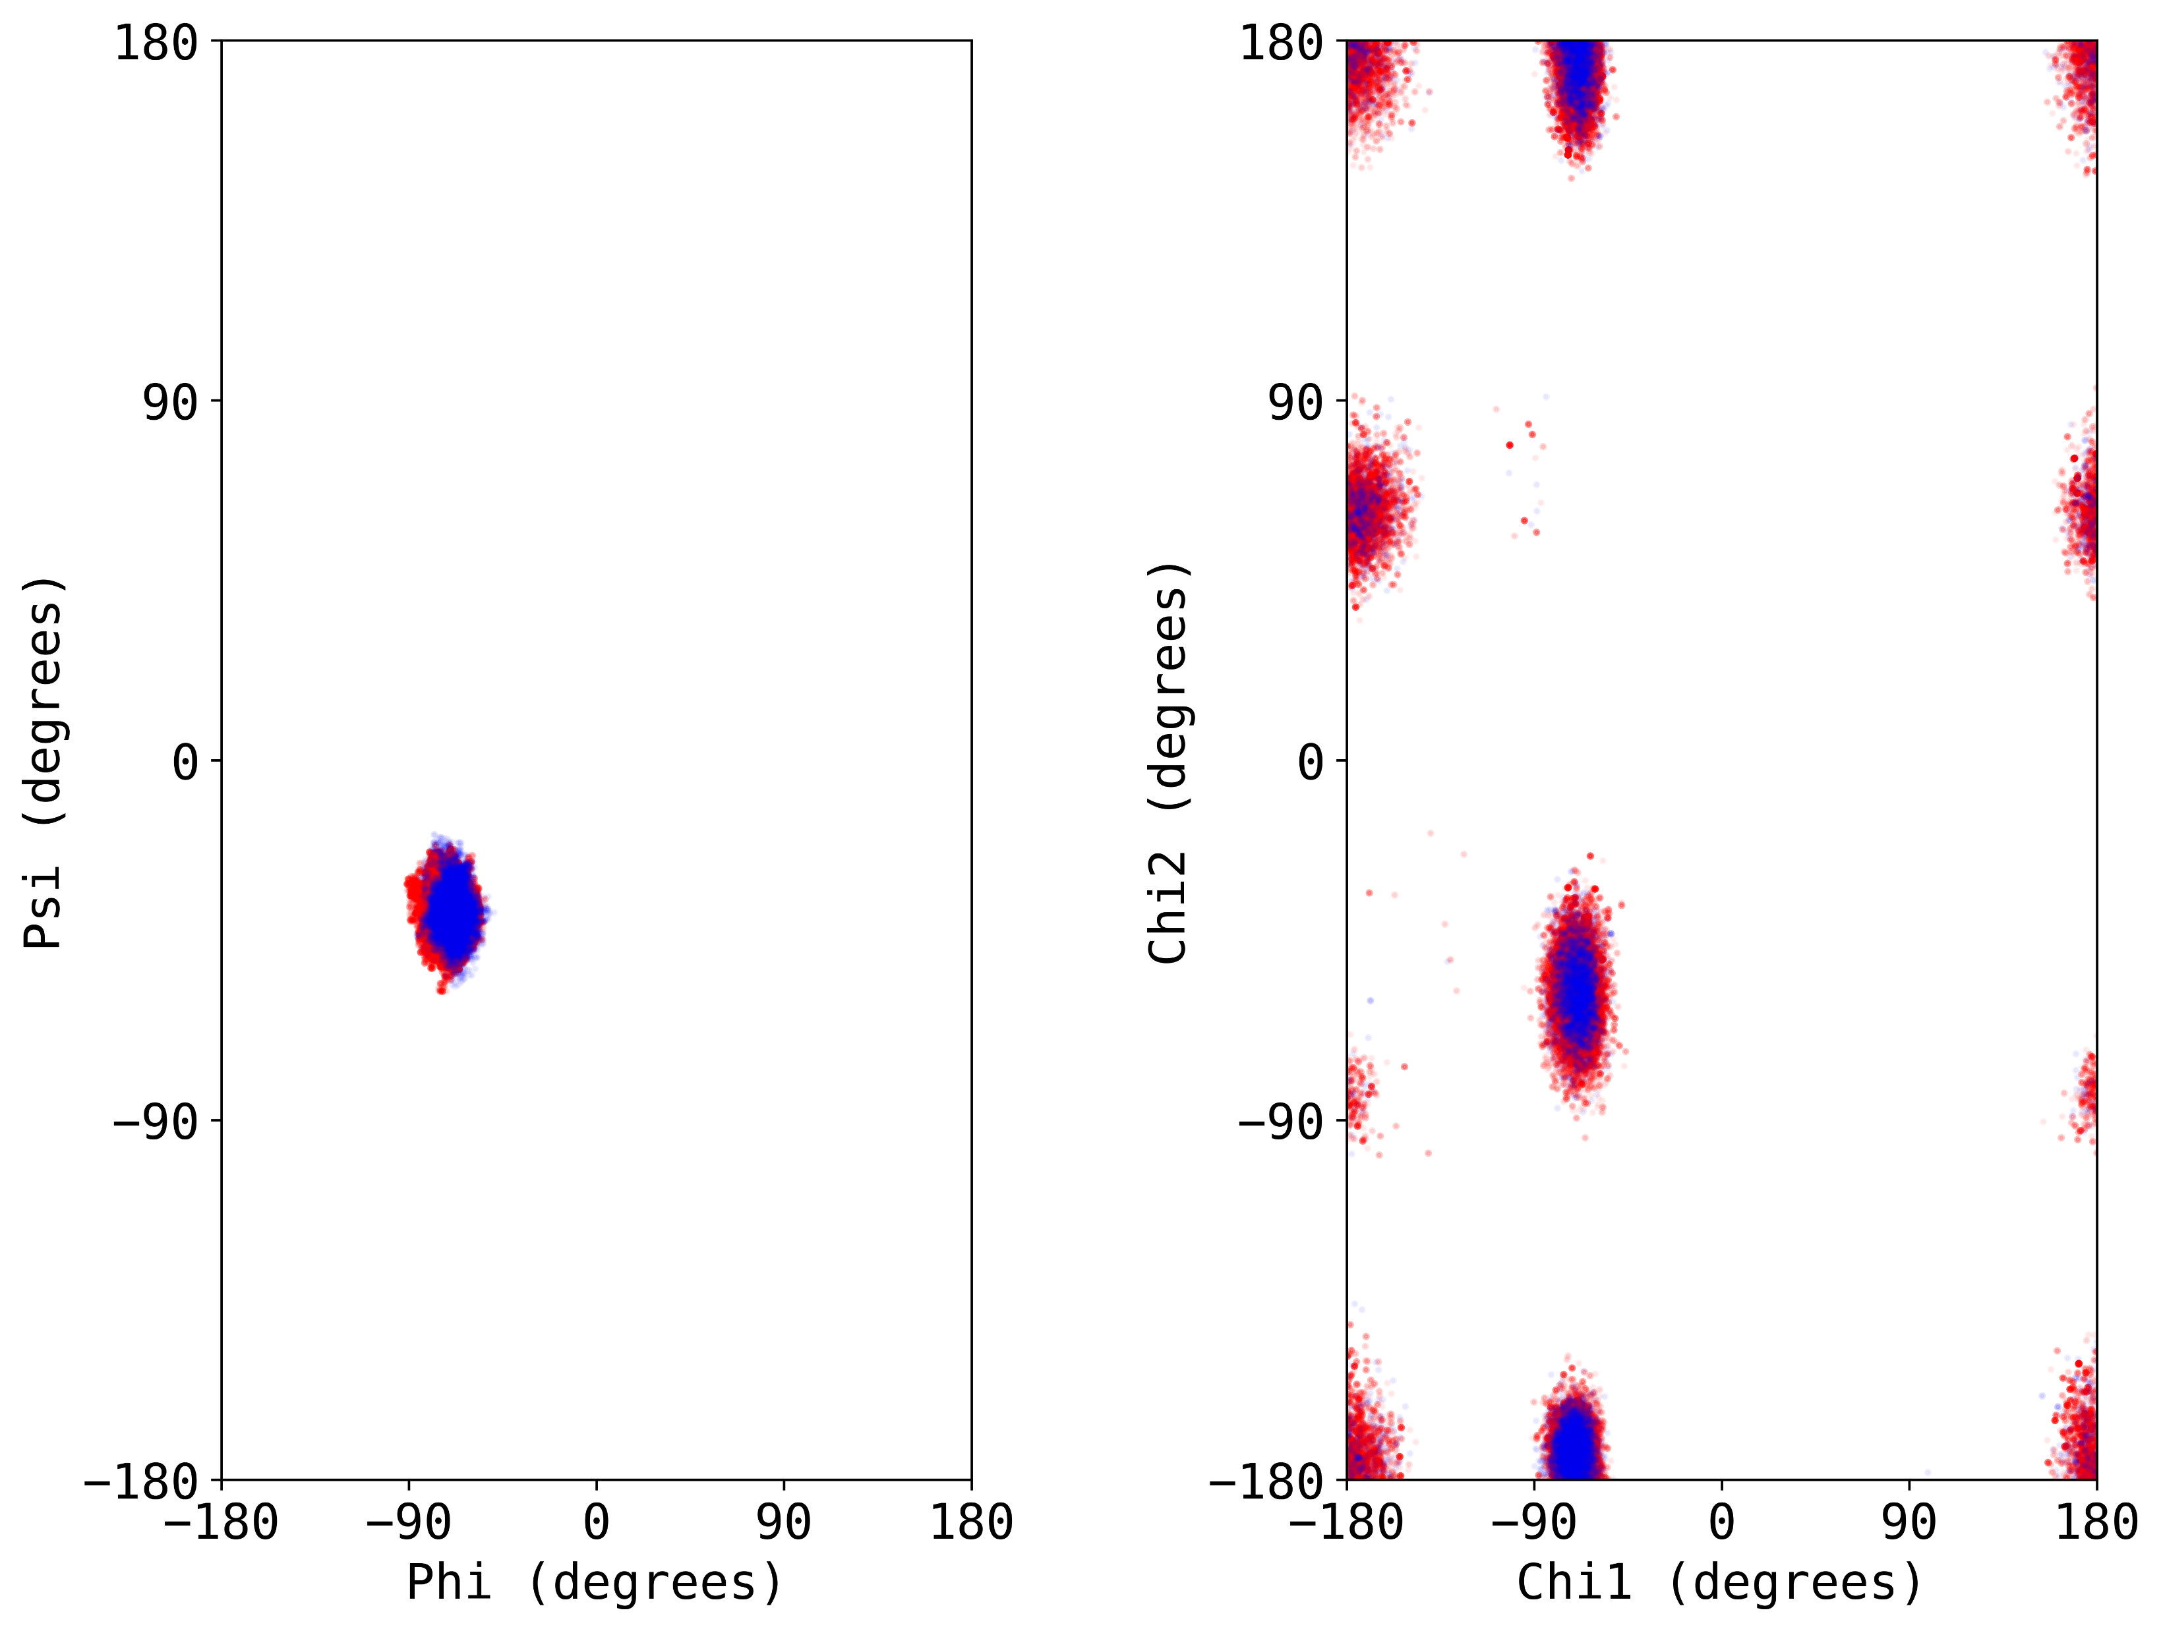
Generating non-canonical amino acid parameters for canonical amino acids using the parent rotamer approach demonstrates success in sampling expected chi1/chi2 distributions
PHE
ASP
MET
Native
*Consistent results across all CAAs with chi1 and chi2 dihedrals
Params Test

Slide 22
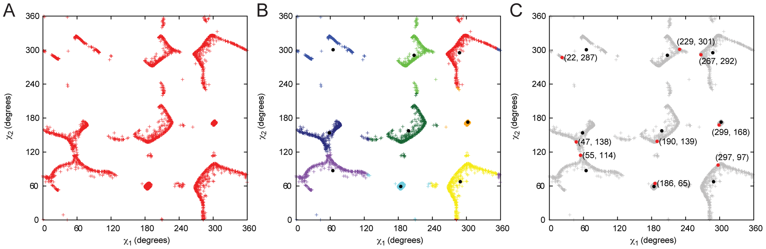
The MakeRotLib application can be used to compute backbone-dependent probabilities of discrete sidechain conformers
Renfrew et al., 2012, PLOS One, https://journals.plos.org/plosone/article?id=10.1371/journal.pone.0032637

Slide 23
The MakeRotLib application can be used to compute backbone-dependent probabilities of discrete sidechain conformers
AA_NAME 5FW
OMG_RANGE 180 180 1
PHI_RANGE -180 180 10
PSI_RANGE -180 180 10
EPS_RANGE 180 180 1
NUM_CHI 2
NUM_BB 2
CHI_RANGE 1 0 330 30
CHI_RANGE 2 0 330 30
ROTWELLS 1 3 60 180 300
ROTWELLS 2 12 0 30 60 90 120 150 180 210 240 270 300 330
TEMPERATURE 1
https://www.rosettacommons.org/docs/latest/application_documentation/utilities/make-rot-lib

Slide 24
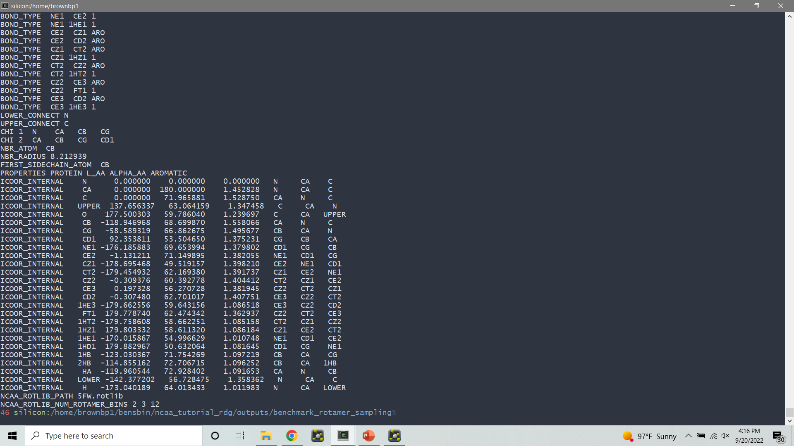
The MakeRotLib application can be used to compute backbone-dependent probabilities of discrete sidechain conformers
Can be used to obtain high-probability rotameric states without statistical data
Highly customizable
May require a priori knowledge of likely rotamers to obtain “native-like” distributions (i.e., may lead to systemic error in packing tasks)
Becomes computationally expensive with larger residues or increasing resolution
Limited to 4 chi rotamer probability bins

Slide 25
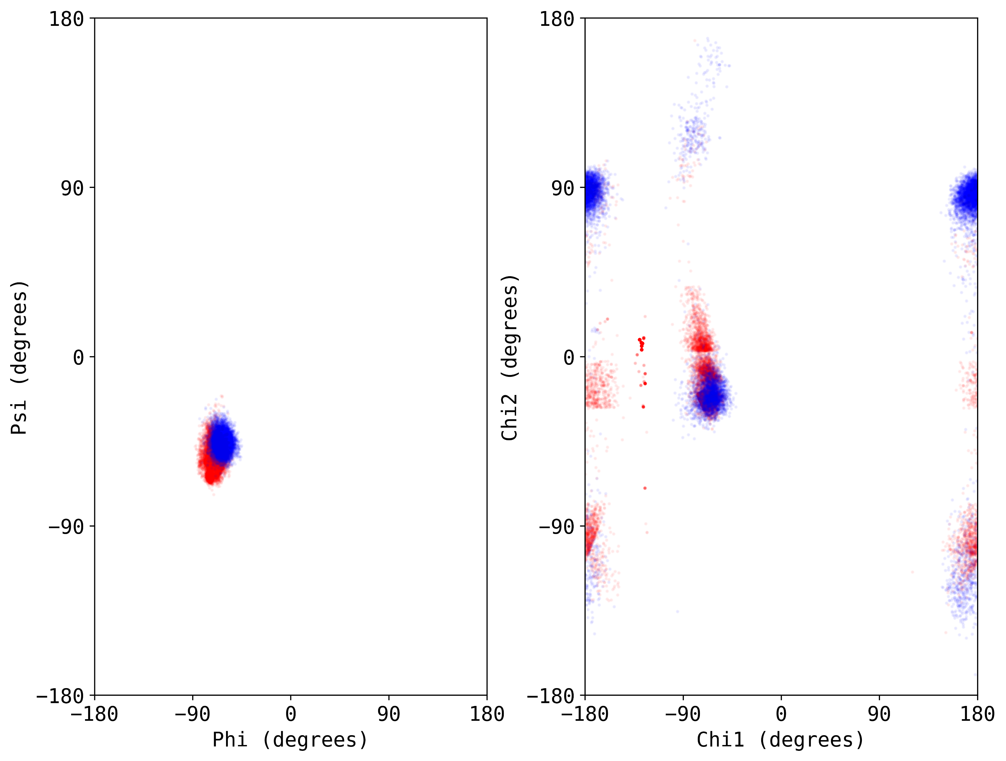
The MakeRotLib application can be used to compute backbone-dependent probabilities of discrete sidechain conformers
TRP
5F-TRP

Slide 26
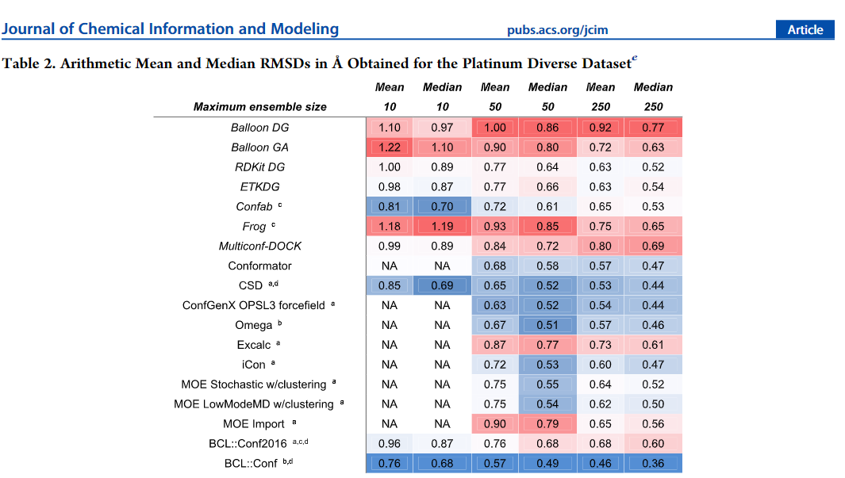
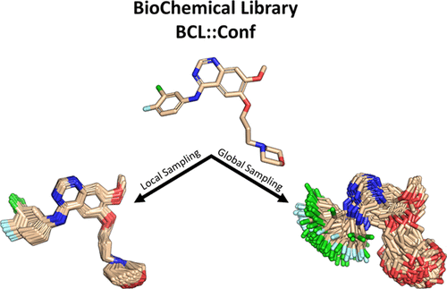
A rapid alternative approach to MakeRotLib is applying small molecule conformer generation algorithms to create the rotamer ensemble
Mendenhall et al., 202, JCIM, https://pubs.acs.org/doi/10.1021/acs.jcim.0c01140?fig=abs1&ref=pdf

Slide 27
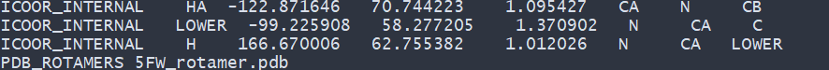
A rapid alternative approach to MakeRotLib is applying small molecule conformer generation algorithms to create the rotamer ensemble
Extremely fast in comparison to MakeRotLib (few seconds, single CPU)
Highly customizable
Not limited by 4 chi rotamer probability bins
Inherently non-rotameric (i.e., yields continuous distributions)

Slide 28
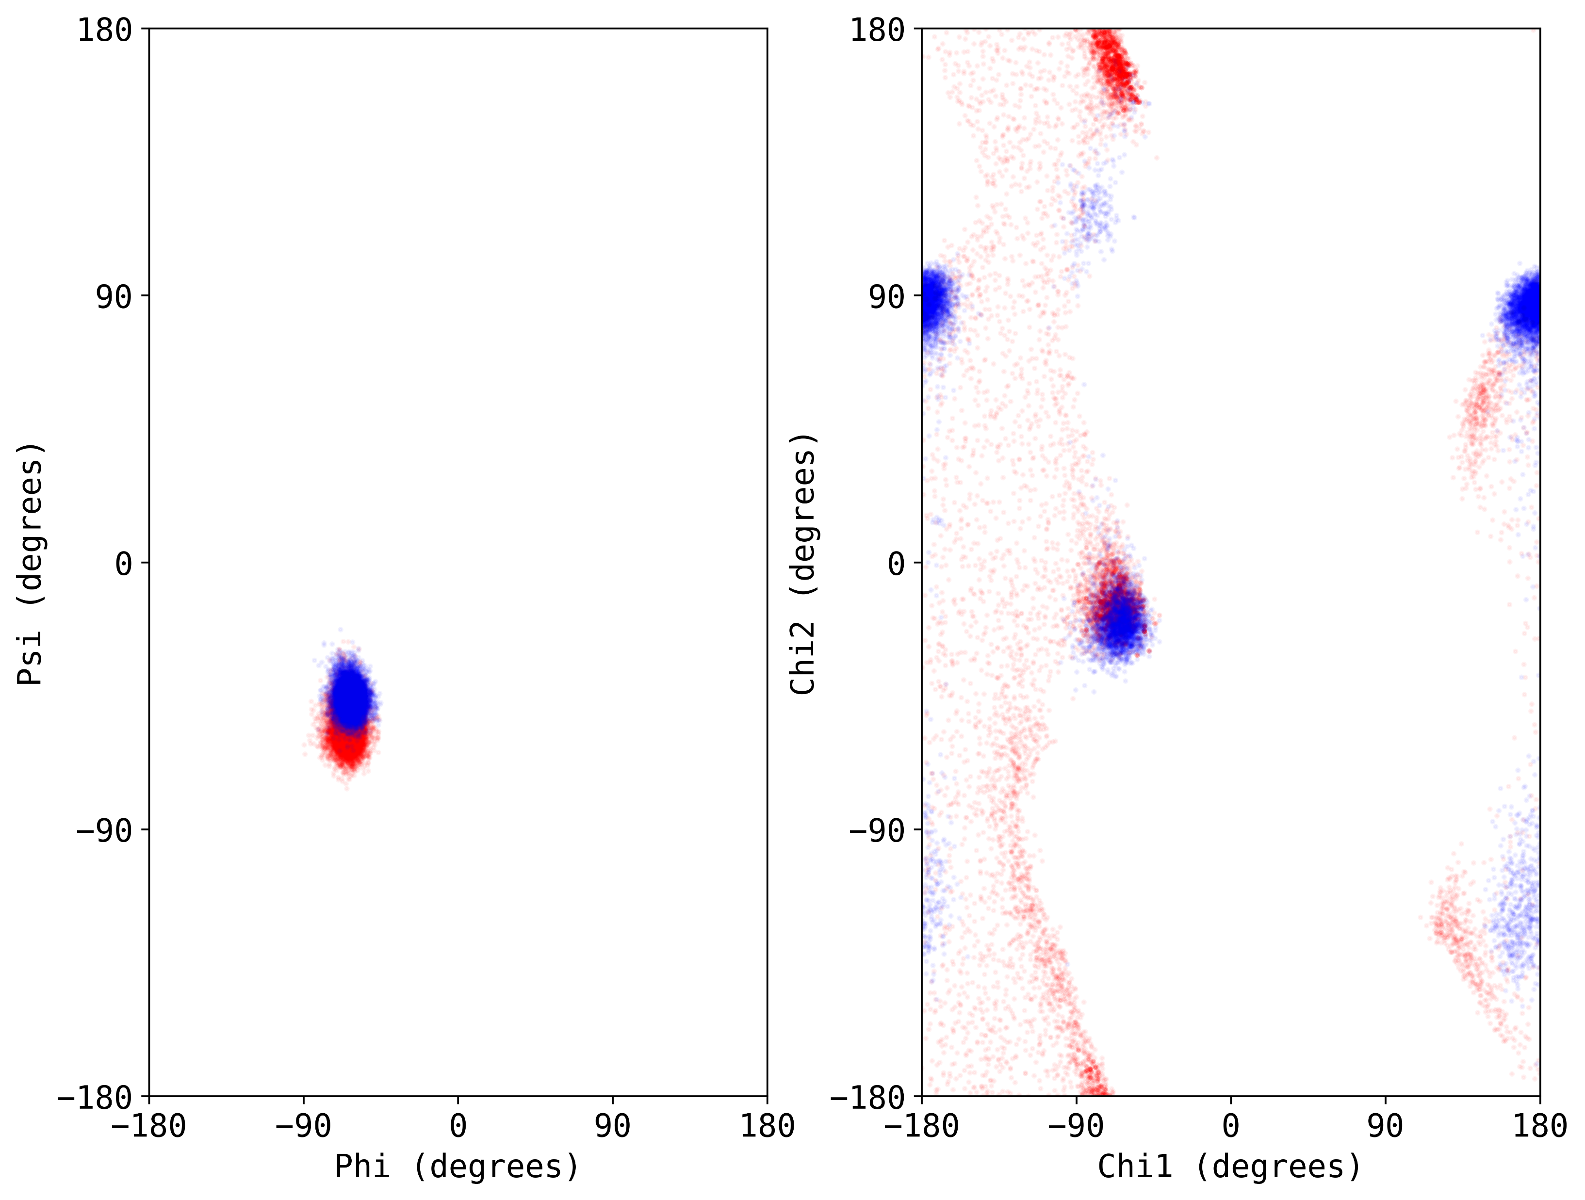
A rapid alternative approach to MakeRotLib is applying small molecule conformer generation algorithms to create the rotamer ensemble
TRP
5F-TRP

Slide 29
There are two primary ways to use params files generated for non-canonical amino acids
Command-line
For example, use “extra_res_fa” flag with params file
Add to database:
Append the following two lines to your params file:
NCAA_ROTLIB_PATH 5FW.rotlib
NCAA_ROTLIB_NUM_ROTAMER_BINS 2 3 12
Add rotamer library to main/database/rotamer/ncaa_rotlibs/
Add params to main/database/chemical/residue_type_sets/fa_standard/residue_types/l-ncaa/
Update main/database/chemical/residue_type_sets/fa_standard/residue_types.txt with the params filename

Slide 30
Questions?

Slide 31
This presentation will combine lecture materials with a live tutorial on non-canonical amino acid parameter creation
Overview of Rosetta params files
Methods with which to generate rotamer libraries
Step-by-step summary of how to generate params files
Live tutorial on params generation
Discussion on reference energies for non-canonical amino acids

Slide 32
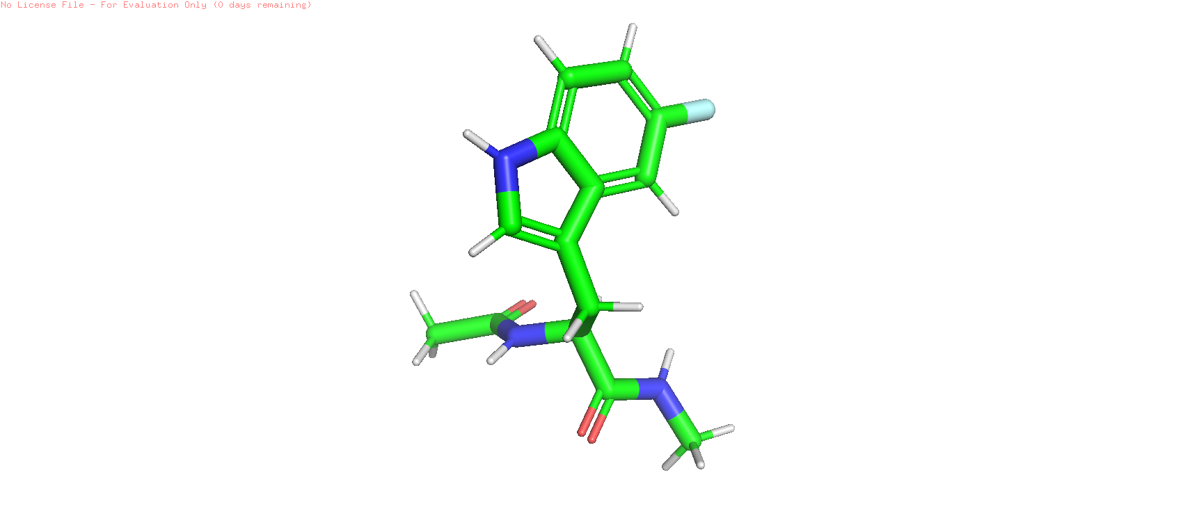
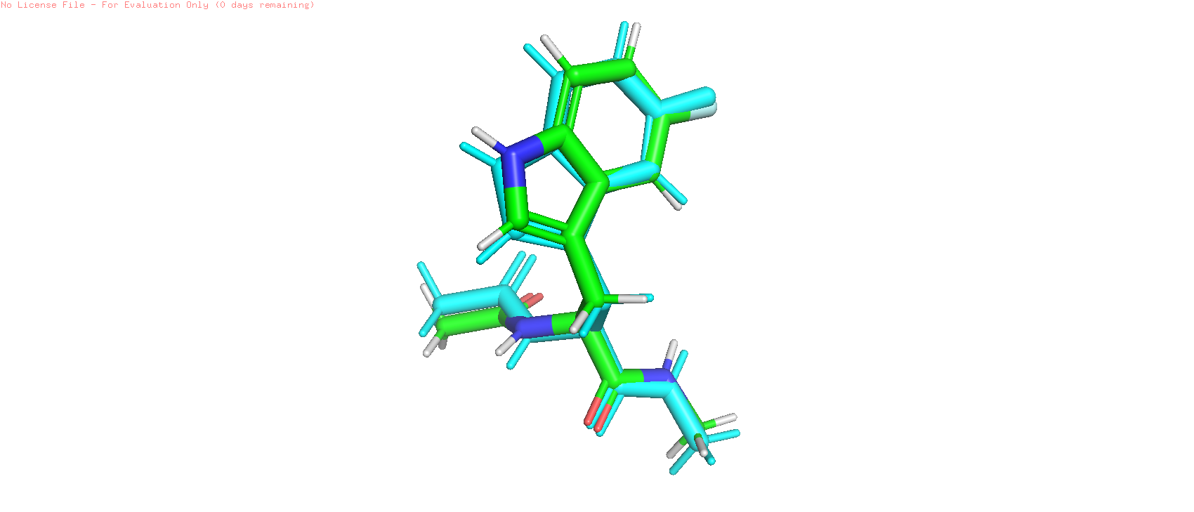
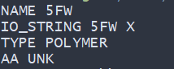
The specific pipeline for generating NCAAs will differ depending on the rotamer method you choose, but the overall pipeline is similar
(1)
Prepare a structure file of the NCAA as a dipeptide
(2)
Optimize the geometry of the dipeptide
(3)
Create a Rosetta topology instructions file
(4)
Generate params file
(5)
Assign rotamers
M ROOT 2
M POLY_N_BB 2
M POLY_CA_BB 3
M POLY_C_BB 1
M POLY_O_BB 14
M POLY_IGNORE 17 18 30 31 32 33 20 34 35 36
M POLY_UPPER 19
M POLY_LOWER 16
M POLY_PROPERTIES PROTEIN L_AA ALPHA_AA AROMATIC

Slide 33
The focus of this tutorial is monosubstituted α-branched amino acids; however, other variants can be parameterized for use in Rosetta
Currently available in Rosetta
In-development
α-branched (mono-,di-substituted)
β-branched (mono-,di-substituted)
Peptoids
Oligooxopiperazines
Oligosaccharides
N-methylated
N-cyclic (i.e., proline-like)
Sidechain conjugations

Slide 34
Questions?

Slide 35
This presentation will combine lecture materials with a live tutorial on non-canonical amino acid parameter creation
Overview of Rosetta params files
Methods with which to generate rotamer libraries
Step-by-step summary of how to generate params files
Live tutorial on params generation
Discussion on reference energies for non-canonical amino acids

Slide 36
Questions?

Slide 37
This presentation will combine lecture materials with a live tutorial on non-canonical amino acid parameter creation
Overview of Rosetta params files
Methods with which to generate rotamer libraries
Step-by-step summary of how to generate params files
Live tutorial on params generation
Discussion on reference energies for non-canonical amino acids

Slide 38
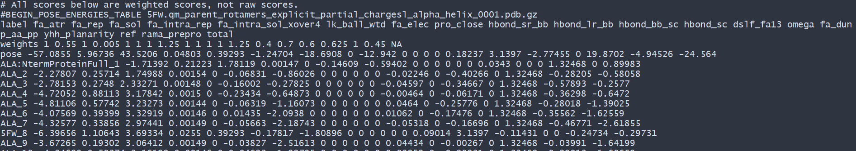
Reference energies are intended to promote native-like sequence recovery during design by incorporating a statistical representation of the unfolded state energy of each amino acid type

Slide 39
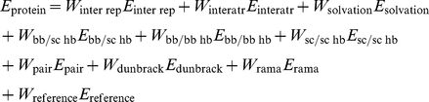
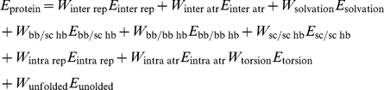
Reference energies are intended to promote native-like sequence recovery during design by incorporating a statistical representation of the unfolded state energy of each amino acid type
-score::weights mm_std
Renfrew et al., 2012, PLOS One, https://journals.plos.org/plosone/article?id=10.1371/journal.pone.0032637

Slide 40
Recommendations for score function selection when designing peptides with non-canonical amino acids
Use the REF2015 score function for protein-protein interactions
Use the Talaris2014 score function for protein-ligand interactions
Do not compare sequences on the basis of an unmodified total_score
Make use of metrics whose thermodynamic cycle cancels ref
ΔΔG

Slide 41
Questions?

